Slide 1
Aroma Creations Website
Project No -1

Slide 2
Group Members
Name Roll. No
Arun Sharma 08
Harsh Mistry 30
Kashyap Patel 50
Krishna Shah 54
Uma Ranawat 101

Slide 3
Project Definition
Aroma Creations is a start up in Arts and Crafts business. It offers you variety of handmade and machine made customized decorations or gifts.
This website gives the business a dynamic look which allows the entrepreneurs to expand its consumer base and reach out to customers within the city.
It enables a web user to browse through the categories of products available, order or customize them and get order delivered.

Slide 4
Scope of Project
Registration and Maintenance of User Account
Browse the products
Customize the products if required
Add to Cart
Order placement
Order Details
Provision of admin account for maintenance of all products

Slide 5
Tools
For Website:
IDE – NetBeans IDE 8.0.2
Web Server – Apache Web Server
Database – MySQL database with phpMyAdmin
Display – Web Browser

Slide 6
For Diagrams:
SmartDraw
For Documentation:
Microsoft Word
For Presentation:
Microsoft PowerPoint

Slide 7
Technologies:
Front-End:
HTML5
CSS
JavaScript
Back-End:
PHP
SQL
SMTP
OTP

Slide 8
Modules
Customer Management
Admin Management
Cart Management
Product Management
Stock Management
Category Management
Order Management
Customized Order Management

Slide 9
Features:
Customer Management
Register and Login
Forgot Password
View account or cart details
View and select products
View Order Summary
Admin Management
Login with admin dashboard
Add , update, delete or view products

Slide 10
Cart Management
Add, update or delete products from cart
Display cart details
Product Management
Search products
Display products with details
Customization for few products
Stock Management
Manage stock of products

Slide 11
Category Management
Add , update or delete category
Order Management
Generate Bill
Show Order Details
Cancel order till some time
Customized Order Management
Customize certain products
Show Order Details

Slide 12
Tentative Work Distribution:
Group Members | Modules
Arun Sharma | Customer Management Admin Management
Harsh Mistry | Product Management Cart Management
Kashyap Patel | Order Management Stock Management
Krishna Shah | Product Management Customized Order Management
Uma Ranawat | Category Management Customized Order Management

Slide 13
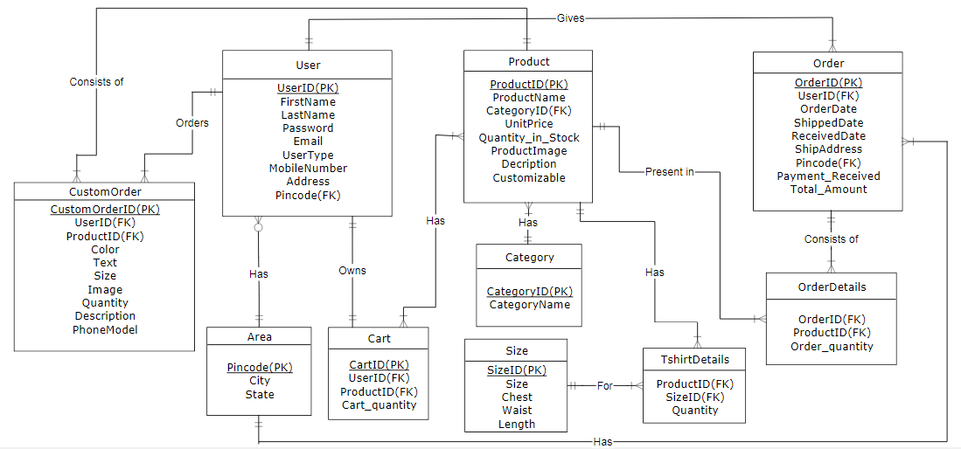
ER Diagram

Slide 14
Thank You

